Slide 1
JOB HUNT: Extracting Opportunities from the web
PROJECT GUIDE
P.NIHARIKA
STUDENT NAMES AND ROLL NUMBERS
JULURU CHAITANYA SAI - 22AG1A6795
B.KOULINYA SHARVANI - 22AG1A67A3
CHIPPABATHINI VIKAS - 22AG1A6780

Slide 2
TABLE OF CONTENTS
INTRODUCTION
01
EXISTING SYSTEM & DRAWBACKS
02
03
LITERATURE SURVEY
PROPOSED MODEL
04
05
REQUIREMENTS GATHERING

Slide 3
06 SYSTEM ANALYSIS & DESIGN
07 IMPLEMENTATION
08 TESTING
09 RESULTS
10 CONCLUSION
FUTURE WORK
REFERENCES

Slide 4
01 INTRODUCTION TO JOB HUNT
The job market is increasingly competitive, and job seekers often find it challenging to keep track of new job postings across multiple platforms.
The process of manually searching for jobs can be time-consuming and inefficient.
This project aims to develop a system that automates the extraction and processing of job opportunities from various online sources, providing job seekers with timely and relevant job listings tailored to their preferences.

Slide 5
02 EXISTING SYSTEM
Current job search platforms typically require users to manually search for job listings on individual websites.
Popular job boards like Careerbuilder, LinkedIn, and Indeed aggregate job postings but still rely on users to filter and sift through numerous listings to find relevant opportunities.
Many company career pages also require job seekers to visit multiple websites, further complicating the job search process.
job seekers with timely and relevant job listings tailored to their preferences.

Slide 6
EXISTING SYSTEM DRAWBACKS
01
Manual Effort
Time-Consuming
02
03
Limited Customization
Update Delays
04

Slide 7
03 LITERATURE SURVEY
This literature survey give the key technologies and methodologies involved in designing and developing a web application for job scraping and user notifications. Utilizing PHP and Python libraries like Scrapy for back end and data extraction, HTML and CSS for web page structuring, and backend frameworks like Flask or Django for integration, the project aims to provide an efficient solution for job seekers to stay informed about relevant job opportunities.
CITATIONS-
Gupta, S., (2021). “Job Market Analysis Using Web Scraping: A Study on LinkedIn.” Journal of Data Mining and Knowledge Management Process.
Zhang, Y., (2020). “Large-scale Job Data Extraction Using Scrapy: A Case Study on Indeed.” International Journal of Web Information Systems.

Slide 8
01
02
03
Advanced Filtering & Search Options
Portfolio Integration
Company Insights & Reviews
04 PROPOSED MODEL

Slide 9
05 REQUIREMENTS GATHERING
5.1 SOFTWARE AND HARWARE REQUIEMENTS
SOFTWARE REQUIREMENTS
Front-end languages - HTML, CSS, JavaScript
Back-end languages –PHP, python libraries (Scrapy), MySql
Text editor/IDE for writing code and editing.
HARDWARE REQUIREMENTS
Operating System : Windows 11
System Processor : Intel i3 configuration with storage of 50GB
RAM: 4GB
Reliable internet connection

Slide 10
5.2 FUNCTIONAL AND NON-FUNCTIONAL REQUIEMENTS
01
Functional Requirements:
Ability to search for job listings based on specific criteria and extraction of job details.
Data storage in a structured format (e.g., CSV, database).
02
Non-Functional Requirements:
Scalability to handle a large number of job listings.
User-friendly interface for non-technical users.
03
Technical Feasibility:
Tools and Technologies
Infrastructure
Economic Feasibility
04
Cost Analysis
Return on Investment

Slide 11
5.3 DATA COLLECTION
Target Job Portals: Select key job sites like LinkedIn and Indeed.
Set Up Scraping Tool: Use Python (Scrapy/BeautifulSoup) and PHP for data retrieval.
Define Data Points: Collect job titles, descriptions, locations, etc.
Develop Scraper: Create logic to extract data, handle pagination, and ensure compliance with robots.txt.
Store and Validate Data: Save data in a database or CSV; validate for accuracy and relevance.
User Preferences: Allow users to set job preferences for tailored results.
Automated Notifications: Notify users of matching job listings via email or push notifications.
Continuous Updates: Regularly update the scraper to adapt to changes in website structures.

Slide 12
06 SYSTEM ANALYSIS & DESIGN
6.1 MODULE DESCRIPTION
Web Scraping Module: Uses Python's Scrapy to extract job listings from LinkedIn and Indeed, gathering details like titles, descriptions, and deadlines.
Backend Processing Module: Built with PHP, it manages data retrieval and storage.
User Interface Module: Created with HTML and CSS, it displays job listings in a user-friendly format.
Notification Module: Alerts users about relevant job opportunities based on their preferences.

Slide 13



METHODOLOGY
Data Collection
1
2
Data Preprocessing
3
Opportunity Analysis

Slide 14
6.2 SYSTEM ARCHITECTURE
Web Application Backend (Python)
Resume Module
Recommendation System
Web scraping data
User Interface
(HTML/CSS/JS)
Notification
(Email/SMS)
Logic Layer
User Profile
Job Posting Management
Job Matching Algorithm
Analytics and Reporting
Security
Authentication and Authorization
Data Base

Slide 15
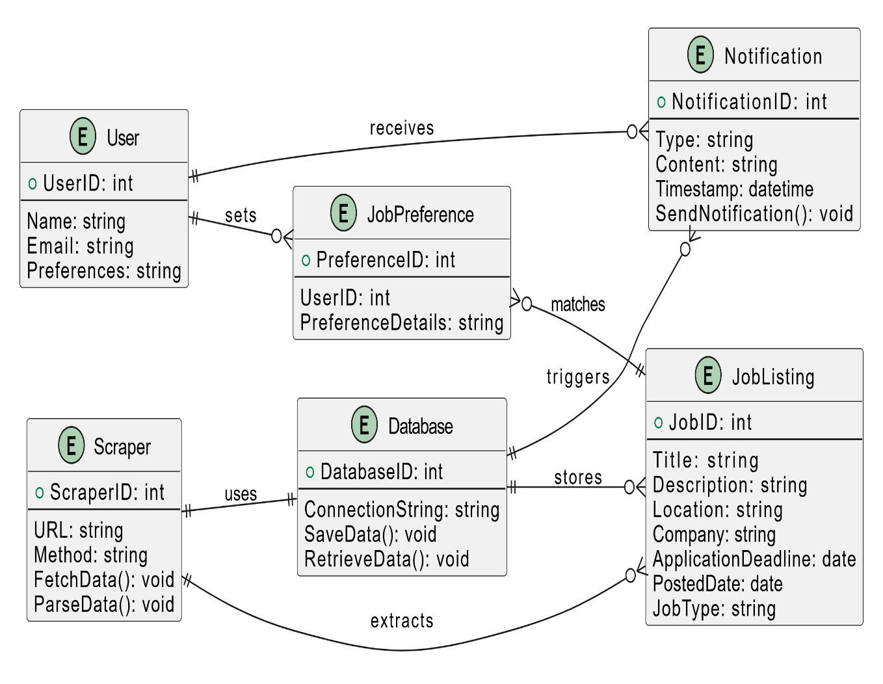
ENTITY RELATION DIAGRAM

Slide 16
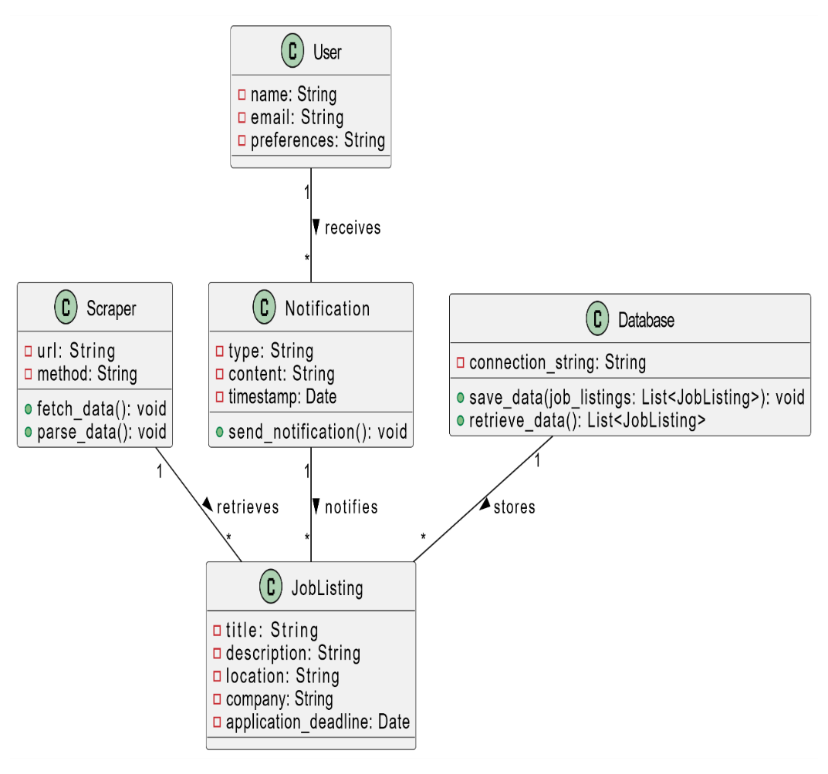
6.3 UML DIAGRAMS
1. CLASS DIAGRAM

Slide 17
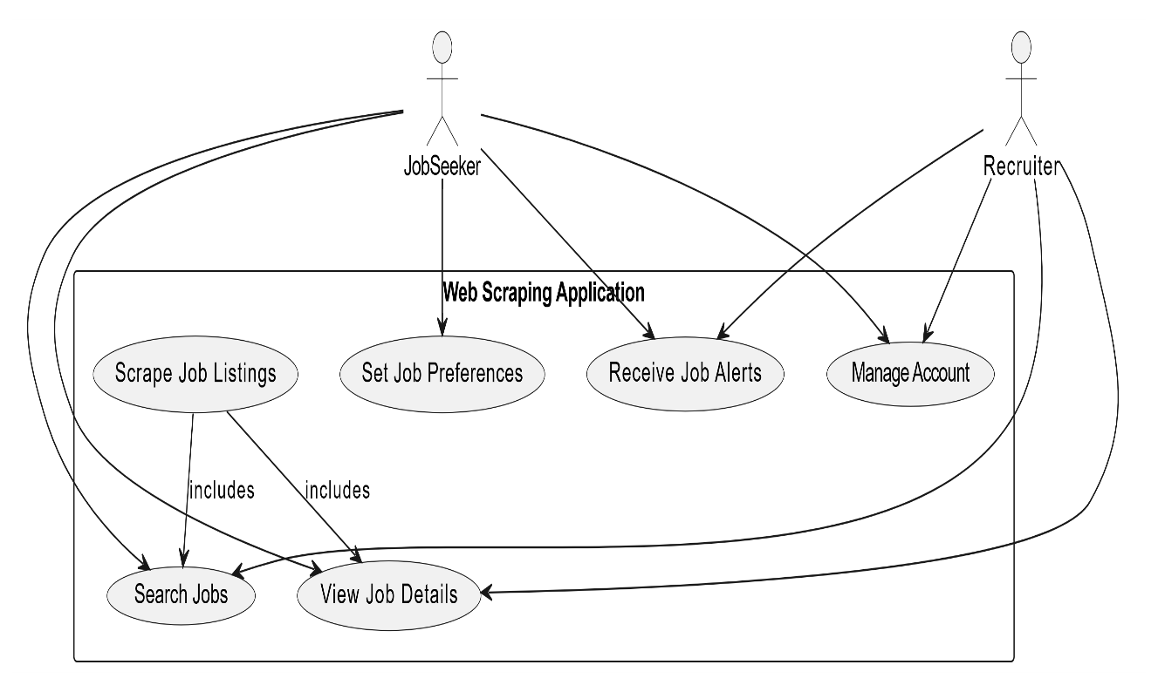
2. USE-CASE DIAGRAM

Slide 18
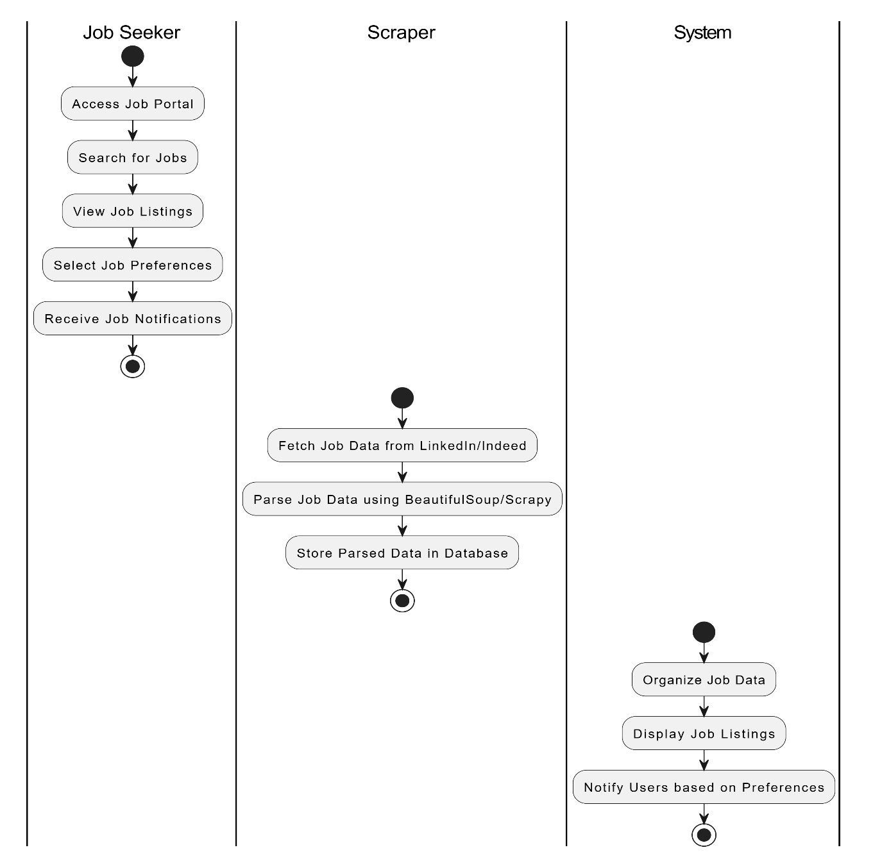
3. ACTIVITY DIAGRAM

Slide 19
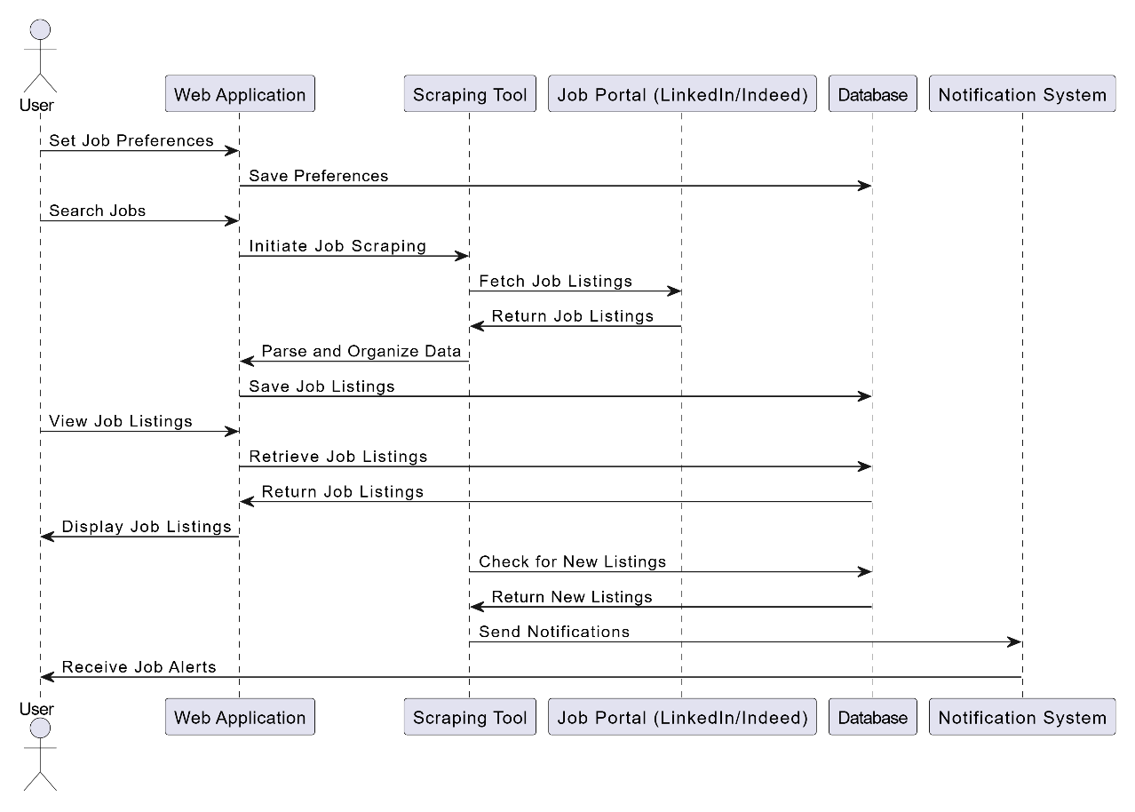
4. SEQUENCE DIAGRAM

Slide 20
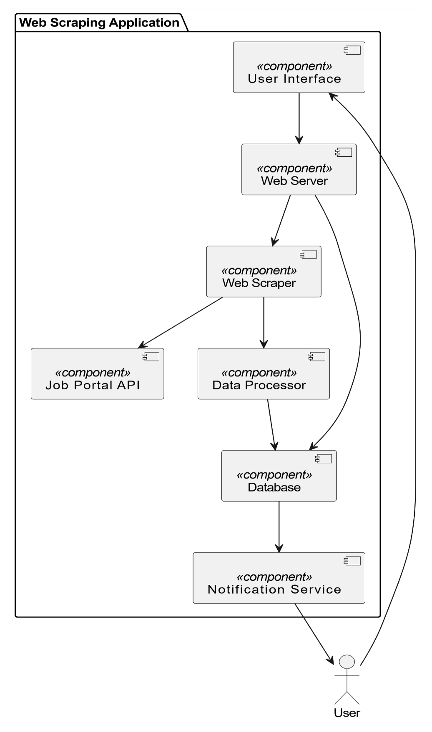
5. COMPONENT DIAGRAM

Slide 21
07 IMPLEMENTATION
ALGORITHM USED
User Preferences: Collect user-defined criteria (job title, location, etc.).
Web Scraping:
Target job portals (LinkedIn, Indeed).
Use Scrapy/PHP to fetch and parse job listings.
Data Filtering: Extract relevant details (titles, locations, deadlines) and filter based on user preferences.
Storage: Save structured data in a database or file system.
Notification System: Compare new data with previous listings and notify users of relevant jobs.
Frontend Display: Use HTML/CSS to present job listings and allow user interaction.
Regular Updates: Schedule periodic scraping and send updated notifications.
Error Handling: Manage issues like CAPTCHA and optimize scraping to avoid IP bans.

Slide 22
08 TESTING
1. UNIT TESTING
Purpose: Verify the functionality of each function or component in the scraping script.
Tools: unittest or pytest in Python.
2. FUNCTIONAL TESTING
Purpose: Ensure the system behaves as expected from the user's perspective.
Tools: Selenium (for automating browser interactions).
3. INTEGRATED TESTING
Purpose: Ensure that the Python script and the PHP interface work together seamlessly.

Slide 23
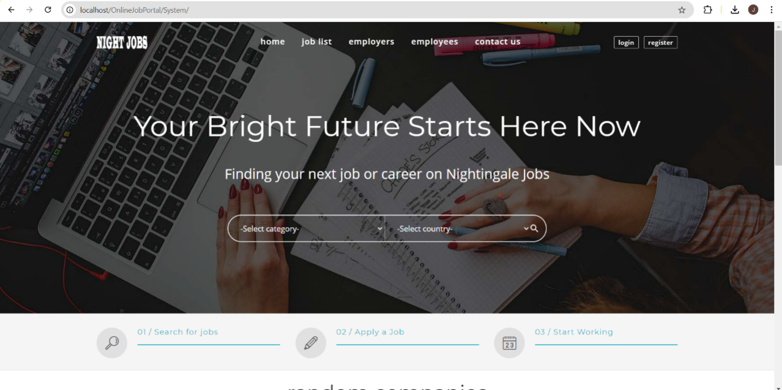
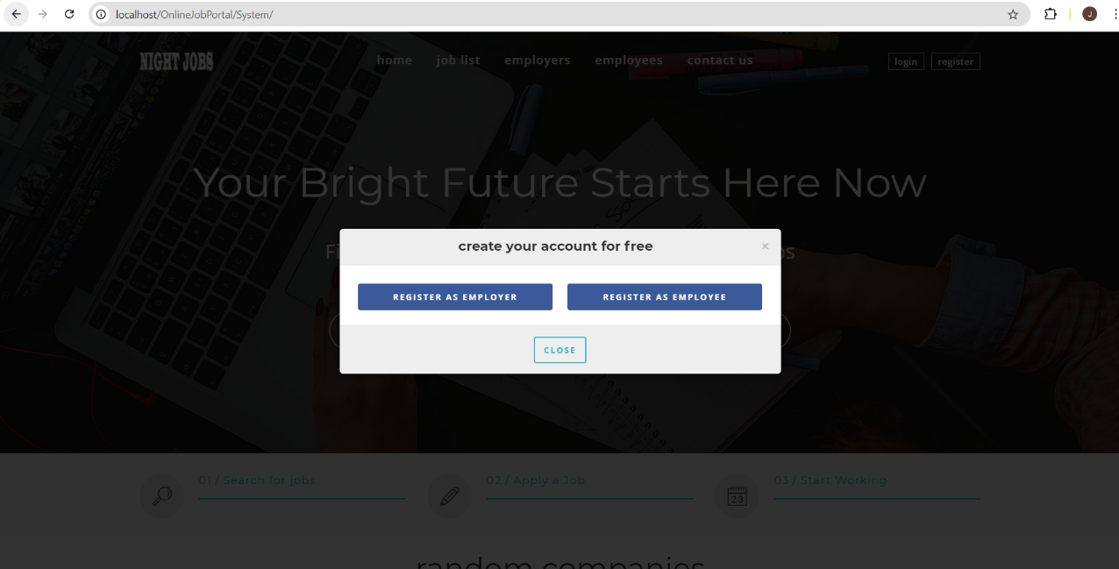
09 RESULTS
The Career scope Connect system delivers various outputs tailored to different user roles, enhancing their experience and functionality within the platform.

Slide 24
10 CONCLUSION
Efficient Job Search: The web scraping application streamlines the job search process by automatically retrieving and organizing job listings from multiple portals, saving time and effort for users while ensuring they receive up-to-date and relevant job opportunities.
Enhanced Decision-Making: By providing structured and comprehensive job data, the tool supports data-driven decision-making for both job seekers and recruiters, leading to improved efficiency and effectiveness in navigating the job market.

Slide 25
FUTURE WORK
Enhanced Data Analysis and Visualization: Integrate advanced analytics and visualization tools to provide insights into job market trends, salary ranges, and industry demand, helping users make more informed career decisions.
Machine Learning Integration: Implement machine learning algorithms to personalize job recommendations based on user behavior, preferences, and historical data, improving the relevance and accuracy of job notifications.

Slide 26
REFERENCES
[1] Literature review on online job portal
https://ijarcce.com/upload/2017/may-17/IJARCCE%2019.pdf
[2] Pinjari, M., De, N., Kokne, R., Siddiqui, A., & Chitre, D. (2019). Online Job Portal. International Research Journal of Engineering and Technology.
[3] Mithun, G. (2020). A Project Report On Job Portal (Doctoral dissertation, CMR Institute of Technology.Bangalore).
[4] Khan, M. S., & Khan, M. S. (2015). Online job portal (Doctoral dissertation, University of Management and Technology Lahore).

Slide 27
THANK YOU

